Slide 1

Python Preparation
Letitia Etsebeth
15597601
6 February 2012

Slide 2

Python Preparation
Letitia Etsebeth
15597601
6 February 2012

Slide 3
Question 2a Custom ROT 13
The ASCII numerical bases of each character in the string (for) was used.
If the uppercase representation of the char was between ‘A’(65) and ‘M’(77) inclusive then 13 was added to the ASCII number of the original case char and converted into a new character.
If the uppercase representation of the char was between ‘N’(78) and ‘Z’(90) inclusive then 13 was subtracted from the ASCII number of the original case char and converted into a new character.
Why add and subtract?
If the character was non-alphabetic no changes are made.

Slide 4
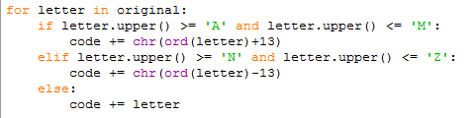
Code…

Slide 5
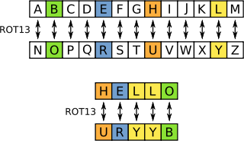
Question 2b Encoding/Decoding
The process is the same because ROT13 divides the alphabet in 2, making it symmetrical.
This means that 2 letters are paired and they refer to each other and enables a single program to encode data as well as decode it.
E.g. If A is encoded it becomes N and if N is encoded it becomes A. (If N is decoded it becomes A and if A is decoded it becomes N)

Slide 6
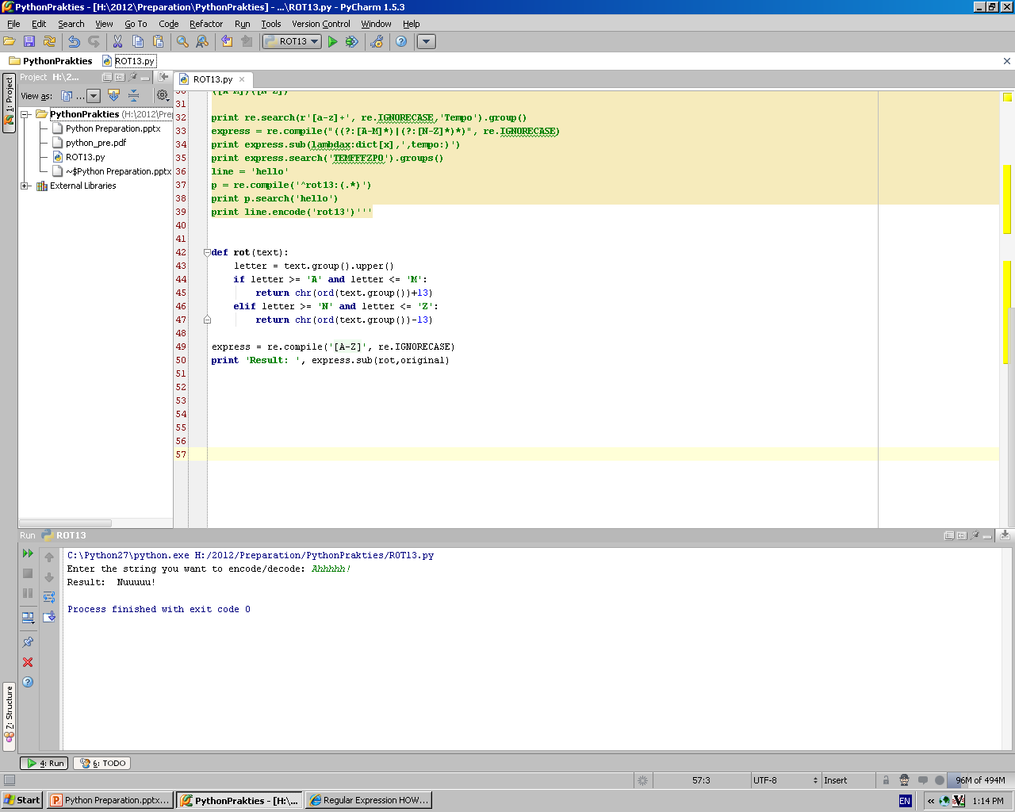

Question 3 Regular Expressions
First a pattern object was created containing a class of the letters A-Z as well as an optional flag to ignore the case of letters.
The sub() method was used to modify a given string by replacing certain characters with the appropriate letter.
To determine what letter needs to be substituted for every given letter a function was used, called rot13, that contained similar code as in Question 2.

Slide 7
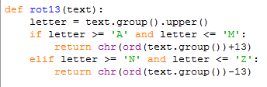
Code…

Slide 8
Question 4a Encoding: ASCII – Base64
Step 1 – Get the ASCII bit pattern
Read the text from the file
Get each character’s ASCII value and convert it to a binary format. Ensure it contains 8 bits by padding 0’s to the front
Add all the bytes together in a continues string
Ensure that the length of the string is a multiple of three. (Must contain pairs of 3 bytes)
Not a multiple of 3?
If part of 1 byte is present, pad it with 0’s at the end to make 6 bits and add a ‘=‘ (One substitution character = 2 bytes)
If part of 2 bytes are present, pad the last byte with 0’s at the end to contain 6 bits and add ‘==‘ (Two substitution characters = 1 byte)

Slide 9
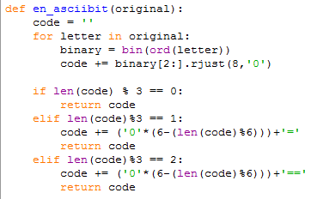
Code…

Slide 10
Encoding: ASCII – Base64
Step 2 – Divide the bit pattern into blocks of 6 bits
Split the bit pattern string into a list .
While the length of the list is longer than 6 bits concatenate the first 6 bits in a string and add is to a new list as well as deleting it from the bit pattern list.
Continue doing this until there are less than 6 bits left (e.g. the ‘=‘ signs) and then just add the remainder to the new list.
The new list now contains items of 6 bit bytes each and/or the substitution signs.

Slide 11
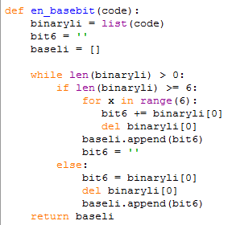
Code…

Slide 12
Encoding: ASCII – Base64
Step 3 – Convert the 6 bit bytes into Base64 indexes and the respective characters
Convert every byte to integer – This is the Base64 character index that should be used on the Base64 index table.
The ASCII table contains all the characters in the Base64 table and more, only with different ‘index’ values. So the ASCII table can also be used based on the tables information.
Convert the integers to characters and add the substitution characters to the end if necessary.
Write the concatenated string to the file.
Char | Base64 Index | ASCII value | Adjust
A | 0 | 65 | 65
Z | 25 | 90 | 65
a | 26 | 97 | 71
z | 51 | 122 | 71
0 | 52 | 48 | 4
9 | 61 | 57 | 4
+ | 62 | 43 | 19
/ | 63 | 47 | 16

Slide 13
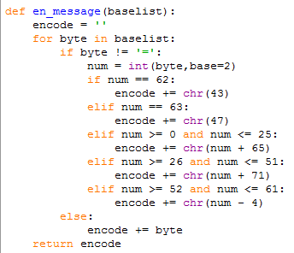
Code…

Slide 14
Question 4b Decoding : Base64 - ASCII
Step1 – Acquire the Base64 index values
Read the text from the file
Get the ASCII value for every character in the text
Adjust the ASCII value based on the information in the table to get the Base64 index value and store each value in a list.
Char | Base64 Index | ASCII value | Adjust
A | 0 | 65 | 65
Z | 25 | 90 | 65
a | 26 | 97 | 71
z | 51 | 122 | 71
0 | 52 | 48 | 4
9 | 61 | 57 | 4
+ | 62 | 43 | 19
/ | 63 | 47 | 16

Slide 15
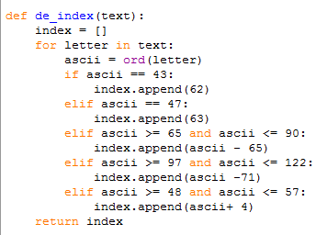
Code…

Slide 16
Decoding : Base64 - ASCII
Step 2 – Convert the integers into 6 bit bytes
Take every index integer in the list and convert it to binary.
Ensure every binary value is 6 bits long by padding it with 0’s in the front.
Concatenate all the 6bit strings into a bit pattern.

Slide 17
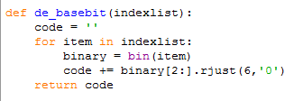
Code…

Slide 18
Decoding : Base64 - ASCII
Step 3 – Convert the bit pattern into bytes of 8 bits
Split the bit pattern string into a list .
While the length of the list is longer than 8 bits concatenate the first 8 bits in a string and add is to a new list as well as deleting it from the bit pattern list.
The residual bits can be ignored since they were only added for padding and substitution.
The new list now contains bytes of 8 bits.

Slide 19
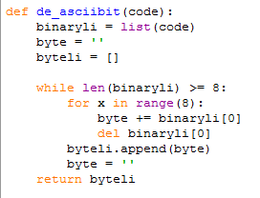
Code…

Slide 20
Decoding : Base64 - ASCII
Step 4 – Convert the bytes to a string of characters
Every byte in the list is converted to an integer.
After that the ASCII representation of that integer is acquired and concatenated to a string.
The string is then written to a new file.

Slide 21
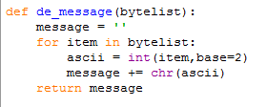
Code…

Slide 22
The End

